Slide 1
IoT Capstone
Katelyn Young

Slide 2
Project Intentions
My project intended to intergrade smart devices into a household so inhabitants could monitor aspects of their house, like temperature and outside motion detection. Residents can also control a relay that would be connected to the lights in the house, allowing them to turn off and on with a message. The devices are simulated in Wokwi simulator to start.

Slide 3
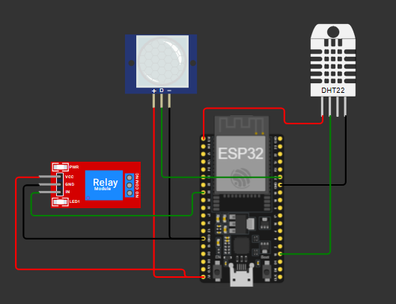
Devices
The project starts with an Esp32 Arduino board that controls the devices. Connected to the board is a PIR motion sensor, meant to simulate an outside motion camera, and a DHT22 temperature and humidity sensor, meant to record the temperature and humidity in the house. There is also a relay that would be connected to lights in a real installation.

Slide 4
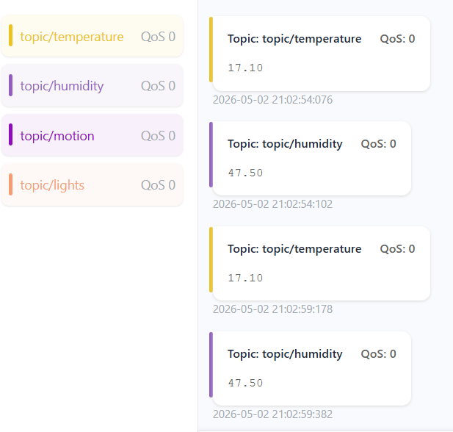
MQTTX
The devices in the simulator send data through MQTT to topics. MQTTX can look over those topics and see what data is sent. MQTTX can also send a message to the lights topic to turn the house lights on and off.

Slide 5
Learnings
There were several learnings and challenges during the project development. Issues with Azure meant it was unusable for development. I gained a deeper understanding of how the data is transferred to MQTT, what will stop it from sending correctly and device specifications.

